Slide 1
Trauma-Informed Assessment Practices and Interventions WASSW October 17, 2015 David Lewis MA,LMHC, CMHS Licensed Mental Health Clinician Child Mental Health Specialist

Slide 2
Today’s Agenda
Define Trauma and Complex Trauma
Define ACES (Adverse Childhood Experiences)
Describe how trauma impacts students ability to be successful in school
Define Resilience and Protective Factors
Describe assessment and diagnosing practices
Interventions in an MTSS or RTI Model

Slide 3
Trauma Informed Educational Model
Phase I
Education of ACES and Complex Trauma
How does trauma impact student learning
Phase II
Teaching and diagnosing practices in an MTSS or RTI model
Family collaboration and engagement
Phase III
Tiered interventions in an MTSS Model
Usage of Assessment tools to track data related to social emotional, and academic growth
Phase IV
Walkthrough and reassessing of practices and interventions
Reimplementation of practices

Slide 4
What is Trauma?
Traumatic Event – an experience that causes physical, emotional, psychological distress or harm.
An ongoing event that is perceived and experienced as a threat to ones safety, or to the stability of ones world.
ACE (Adverse Childhood Experience)-Ongoing traumatic experiences in a child’s life before the age of 18.
The experiences have the capacity to impact children into adulthood.

Slide 5
What are Adverse Childhood Experiences (ACEs)?
Growing up (prior to age 18) in a household with:
Recurrent Physical Abuse
Recurrent Emotional Abuse
Sexual Abuse
Emotional or Physical Neglect

Slide 6
Children are at Risk For:

Slide 7
Toxic Stress, ACEs, Complex Trauma: What does it all mean?

Slide 8
Individual Characteristics
Toxic Content
Protective Content
Impulsive
Hyper Vigilant
Hyper Reactive
Hard to shift Gears
Withdrawn
Emotionally Detached
Numb
Laid Back
Relationship Orientated
Reflective
Able to shift Focus
Can seize Opportunities
Can follow the process over seeking power

Slide 9
Toxic Stress
Simple Trauma
Complex Trauma
Car Accident
House Fire
Earthquake
One time victim of a crime
Physical Injury
Ongoing Physcial Abuse
Emotional Abuse
Domestic Abuse
Untreated Mental Illness (Impacts parenting)
Sexual Abuse
Placement Disruptions

Slide 10
Toxic Stress
Stress is the bodies normal Response to challenging events or environments. Stress is a part of growing up and developing.
Increase heart rate in situations
Stress Increases the amount of stress hormones in the body
Stress hormones return to normal levels quickly
Too much stress-toxic stress occurs when a child is overloaded for an extended period of time.
A child’s brain and body will produce an overload of stress hormones such as cortisol and adrenaline.
Toxic Stress harms the functions and structure of the brain and body.

Slide 11
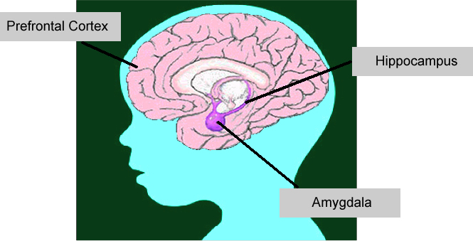
Imbalance in Brain Development
Graphic Courtesy of ECMHC..ORG

Slide 12
Causes of Toxic Stress
Poverty
Depression
Homelessness
Poor nutrition/Hunger
Lack of Healthcare
Chronic medical conditions
Witness to Homicide
Anti social peer groups
Witness to accidental death
Generational Patterns of Inadequate Parenting
Learning Disabilities
Running Away
Transience
History of Suicide
Anxiety
Unemployment
Birth Defects (Fetal Alcohol)
Physical Disabilities
Divorce
Teen Pregnancy
Multiple Changes in Caregivers
Loss or Absence of Parents
Gender Identification Issues
Exploitation
Loss of Parent: Death, Abandonment, Divorce
Emotional Abuse

Slide 13
Reactions to Traumatic & Stressful Events
Hyperarousal: Constantly observing the situation for signs of danger.
Trigger/Re-experiencing the event: Feeling as though the trauma is still happening physically/emotionally.
Automatic physiological response: Fight, Flight, or Freeze.
Avoidance: Avoiding anything that the person associated with the trauma. EX. shut down response in academic environments

Slide 14
Trauma Social Responses
Reactivity and Impulsivity (externalizing behaviors); reacting impulsively to a perceived threat.
Aggression: verbal and/or physical
Defiance: refusing to follow directions or complete tasks.
Withdrawal: reluctance to engage, spacing out, not participating.
Perfectionism: having unrealistic expectations; afraid to disappoint; long-term anxiety.

Slide 15
Trauma and Relationships
Relationships with helper professionals (teachers, counselors, social workers etc):
May be distrustful of adults
Show an inability to attach
Child may try to gain a sense of control and challenge authority (THE TEST).
The child can learn to feel safe when relationships are predictable and non-threatening.

Slide 16
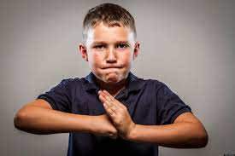
Trauma Social Responses
Relationship with peers
Better to be strong than weak
Misinterpret social cues
Show an inability to attach
Display antisocial behaviors

Slide 17
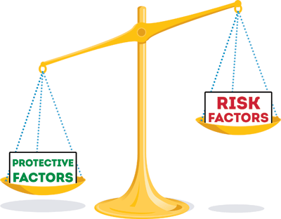
Counterbalance to Trauma
Resilience: positive adaptation within the context of significant adversity.
Resilience is the result of a dynamic set of interactions between a person’s adverse experiences and his or her protective factors.

Slide 18
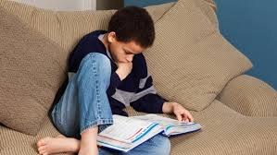
ARC Model – the 3 most important factors for all children.
Attachment – A strong Parent/Child relationship or another caring adult (school staff, teacher, etc).
Self Regulation – Ability to manage emotions and behaviors in pro-social and healthy ways.
Good cognitive skills and competencies
Good cognitive strengths in various areas
An experience of having success (if even small).

Slide 19
Protective Factors
Close relationship with parent or another adult
Caregiver knowledge / Good parenting skills
Individual development competencies and skills (problem solving skills, self regulation, agency).
Children’s social emotional and health connections
Socioeconomic advantages and support for families
Communities that nurture and encourage human capital

Slide 20
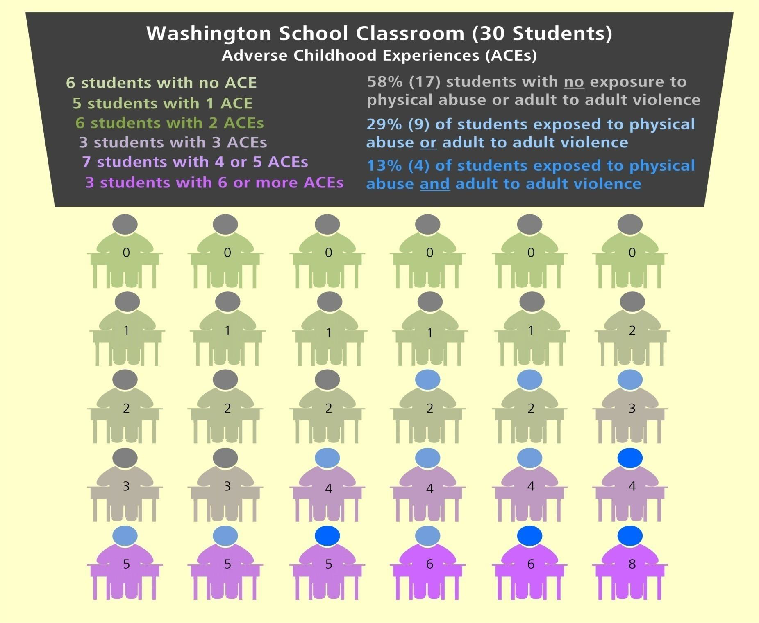

Slide 21
Trauma Informed School Environment
Whole Child approach to promote student academic success and social emotional well being. Evidence shows that these are concretely related!!
Multi-Tiered System of supports that address academic, social emotional, and behavioral expectations and success. (Continuum of supports).
Early and proactive responses to prevention and intervention when recognizing symptoms of anxiety.
Positive School climate where students feels safe!! (Anxiety Level Down)!

Slide 22
Barriers within School Systems
Unprepared & lack of training for staff (information gap).
(Jodi)
After the fact model of interventions (Reactive vs. Proactive).
Mental Health barriers are often not detected, and sometimes difficult to assess. (Example = ADHD & ODD vs. Complex Trauma and ACES)
Students have gaps in educational skills and proficiency that do not get addressed. (Ramone)
Many students in poverty and some minority groups are overrepresented in disciplinary action and special education.

Slide 23
Trauma Informed MTSS

Slide 24
Tier 1
Having an assessment lens of behavioral and social emotional barriers
Evidence Based teaching practices that are consistent & universal
Safe Culture and School Environment
Consistent, predictable schedule and structure = Lowered anxiety
Family Engagement
Positive Relationships
Proactive Classroom management practices that decrease anxiety
Data tracking and assessment system to monitor growth, stagnation, or regression (this may inform further need for additional interventions).

Slide 25
Tier 2
Student group interventions that promote social emotional well being, and growth (Emotion Regulation).
Social Skills groups that promote pro-social applicable skills and healthy relationships.
Check and Connect (modifiable)
Concrete needs support (Family support)
Academic Supports (Tutoring)
Data tracking and assessment system to monitor growth or stagnation (this may inform further need for additional interventions).
Mood Questionnaire
Mood and Feelings Questionnaire
Zung Anxiety Scale
Beck depression Inventory

Slide 26
Tier 3
FBA = Functional Behavior Assessment
504;s = Accommodation relating to a disability
BIP = Behavior Intervention Plan
IEP = Individual Educational Plan
Referral to Mental Health Provider
Mental Health Assessment and Dx (CBCL)
Counseling Support (Cognitive Behavioral Approach)
Wraparound supports (Multi-systemic Approach)

Slide 27
High Expectations With Support

Slide 28
High Expectations with Support:
With clear and set expectations the student has a goal to aim for that is predictable.
When the child meets the expectation, they develop a positive sense of accomplishment and positive sense of self.
Children develop independent skills
Giving children support “a boost” is appropriate.
Too much support does not allow growth.

Slide 29
Children succeed with teachers/staff who:
Who understand the importance of being Authoritative
Who can manage their own behavior and emotions (not get tipped over)
Who can manage and tolerate children's behavior
Who can provide acceptance
Who know the difference between being authoritative and authoritarian
Have an adequate support system
Who have a clear sense of their own identity and how they facilitate the safe structure of a classroom for everybody

Slide 30
Concrete Practices That Work:
Predictability in the Classroom and school environment
Have Expectations and Help Students meet them (Resilience Building)
Clear Directives / Precise Words to minimize questioning
Neutral Tone of Voice and Directives (antennas are up)
Neutral Expression on face (again, antennas are up)
Don’t Over Direct / Make a Directive and Step Away / Hold the
Line
Strength Based Approach – Directives that set up success

Slide 31
Any Questions?
Feel free to contact me!!
David Lewis MA, LMHC, CMHS
PH: 206.579.3810
Email: DavidLPsychology@Gmail.com

