Slide 1
Restorative Justice
A relational approach to conflict

Slide 2
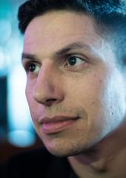
Nicholas Bradford
Founder
National Center for Restorative Justice
@NC4RJ

Slide 3
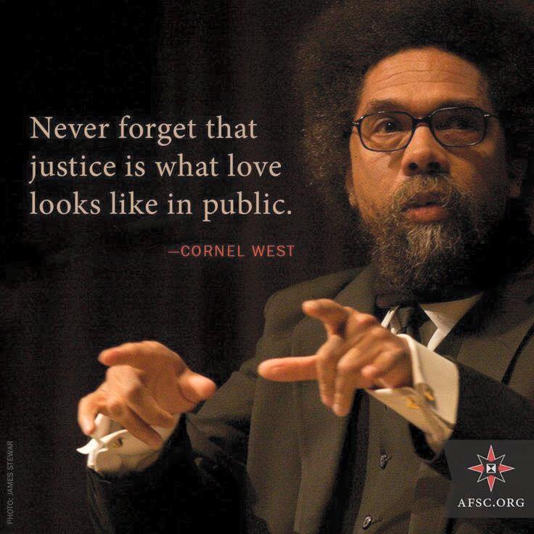

Slide 4
Restorative Justice a definition:
A “relational approach to conflict.”
– National Center for Restorative Justice
  What other ideas come to mind when you’re asked about the definition?
  RJ is much more then a way of dealing with transgressions.
Restorative Practice: the tools we use to create systemic change using RJ principles

Slide 5
Why are we shifting our approach across the country?
Predictors of Success
Predictors of challenges
Strong relationships with adults and other students.
Identifying with the schools, “school bonding”
Skill building
Grit
Connected
Suspension
Absenteeism
Isolation from school
Isolation from “main stream”
Lack of interest in school
*See attached documentation

Slide 6
Philosophy
Conflict Happens
  Teach youth/adults to engage in a healthy & sustainable manner.
Engage all stakeholders
  Everyone who has an interest in the conflict is welcome at the circle.
Empower Author and Victim
  Value the perspectives and input of those who were most directly connected.
Value Empathy
  Use vulnerability to move the conflict away from shame towards empathy.
Develop Agency
  Encourage youth to create their own internal locus of control and define what they need/want.

Slide 7
Conflict Happens, Conflict Aware
When my expectations don’t match with reality.
Teachers are taught to avoid conflict through effective classroom management and curriculum.
Undeveloped adult conflict skills lead to poor modeling/teaching.
Effective classroom management includes “having the difficult conversation.”
Use of RJ and mediation methodology among adults facilitates staff and administrative relationships.

Slide 8
Engage all stakeholders
Everyone who has an interest in the conflict is welcome at the circle.
Teachers, parents and students are rarely consulted in disciplinary decisions.
Lack of participation creates a division between what happened and the outcome.
Teachers, parents and students all have an interest in the outcomes of discipline.
Parents, teachers and students often have very relevant perspective regarding conflict.

Slide 9
Empower Author and Victim
Value the perspectives and input of those who were most directly impacted.
Victims rarely participate in the process.
Punishment rarely facilitates healing for the victim.
Authors are often the “victims” of the justice system.
The process allows for author to take an active role in determining the outcome.
This process creates space for victim input as well as meaningful “acts of apology.”

Slide 10
Value Empathy
Use vulnerability to move the conflict away from shame towards empathy.
Empathy
The experience of connectedness, or the experience of deep and true understanding and inclusion
Shame
The intensely painful feeling or experience of believing we are flawed and therefore unworthy of acceptance and belonging
Vulnerability

Slide 11

Brene Brown: Empathy

Slide 12

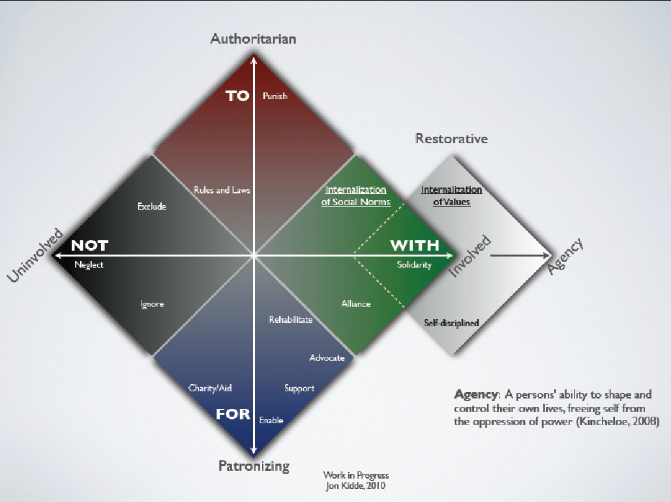

Slide 13

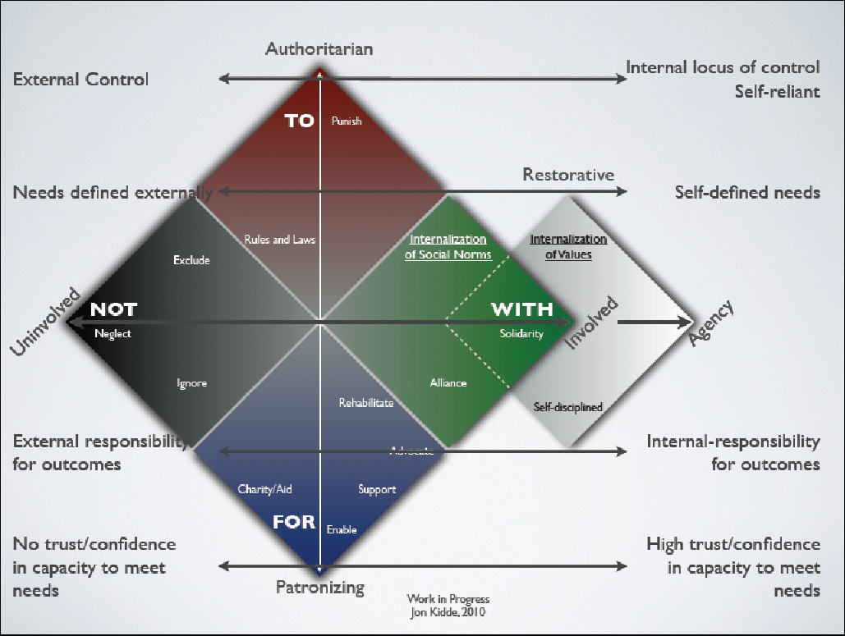

Slide 14
Philosophy
Conflict Happens
  Teach youth/adults to engage in a healthy & sustainable manner.
Engage all stakeholders
  Everyone who has an interest in the conflict is welcome at the circle.
Empower Author and Victim
  Value the perspectives and input of those who were most directly impacted.
Value Empathy
  Use vulnerability to move the conflict away from shame towards empathy.
Develop Agency
  Encourage youth to create their own internal locus of control and define what they need/want.

Slide 15
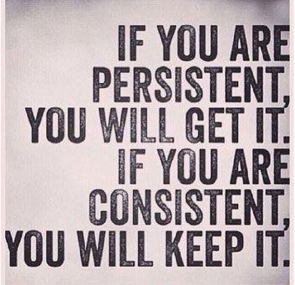
Do the work.

Slide 16
Nicholas Bradford
Founder
@NC4RJ
nationalcenterforrestorativejustice.com
N.Bradford@nationalcenterforrestorativejustice.com

